Slide 1
What is theoretical computer science?
Sanjeev Arora
Princeton University
Nov 2006

Slide 2





The algorithm-enabled economy
What is the underlying
science ?

Slide 3
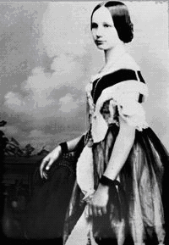
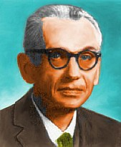
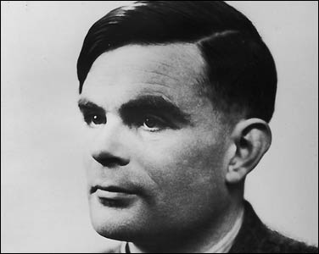
Brief pre-History
“Computational thinking” pre 20th century
Leibniz, Babbage, Lady Ada, Boole etc.
Incompleteness of axiomatic math
Hilbert, Goedel, etc. (~1930)
Formalization of “What is Computation?”;
“What problems can computers never solve?”
Turing, Church, Post etc. (~1936)
“Computation is everywhere” (1940s and onwards)
IBM mainframes, DNA, Game of Life, Billiards Balls,..

Slide 4
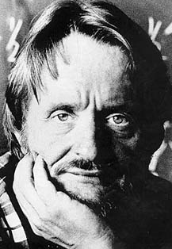
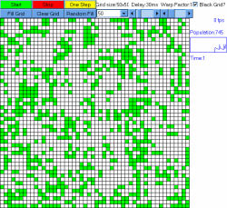
Is it a game, Is it an ecosystem,
Is it a computer? (Game of life, 1968)
Rules: At each step, in each cell
  Survival: Critter survives if it has
  exactly 2 or 3 neighbors
  Death: Critter dies if it has 1 or fewer neighbors,
  or more than 3.
  Birth: If cell was empty and has 3 critters as neighbors, new critter is born.
(J. Conway)
Moral: Computation lurks everywhere.

Slide 5
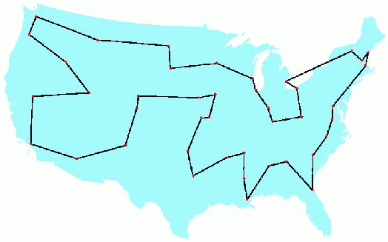
A central theme in modern TCS: Computational Complexity
How much time (i.e., # of basic operations) are needed
to solve an instance of the problem?
Example: Traveling Salesperson
Problem on n cities
n =49
Number of all possible salesman tours = n!
(> # of atoms in the universe for n =49)
One key distinction: Polynomial time (n³, n⁷ etc.)
versus
Exponential time (2^{n}, n!, etc.)

Slide 6
Some other important themes in TCS
Efficiency
common measures: computation time, memory, parallelism, randomness,..
Impossibility results
intellectual ancestors: impossibility of perpetual motion, impossibility of
trisecting an angle, incompleteness theorem, undecidability, etc.
Approximation
approximately optimal answers, algorithms that work “most of the time”,
mathematical characterizations that are approximate (e.g., approximate
max-flow min-cut theorem)
Central role of randomness
randomized algorithms and protocols, probabilistic encryption,
random graph models, probabilistic models of the WWW, etc.
Reductions
NP-completeness and other intractability results (including complexity-based cryptography)

Slide 7
Coming up:
Vignettes
What is the computational cost of automating brilliance?
What does it mean to learn?
What does it mean to learn nothing?
What is the computational power of physical systems?
Will algorithmic thinking become crucial for the social and
natural sciences?
How many bits of a math proof do you need to read to
check it?

Slide 8
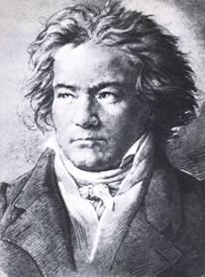
Vignette 1
What is the computational cost of automating
brilliance or serendipity?
(P versus NP and related musings)

Slide 9
Is there an inherent difference between
being creative / brilliant
and
being able to appreciate creativity / brilliance?
Writing the Moonlight Sonata
Proving Fermat’s Last Theorem
Coming up with a low-cost
salesman tour
Appreciating/verifying
any of the above
When formulated as “computational effort”, just the P vs NP
Question.

Slide 10
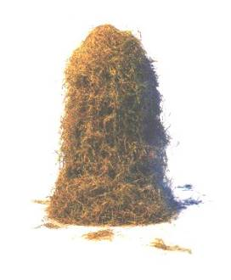
“General Satisfiability”
is NP-complete
Given: Set of “constraints”
Desired: An n-bit “solution” that satisfies them all
(Important: Given candidate solution, it should be easy to
verify whether or not it satisfies the constraints.)
“Finding a needle in a haystack”
“P = NP”
is equivalent to
“We can always find the solution to general satisfiability
(if one exists) in polynomial time.”

Slide 11
Example: Boolean satisfiability
Does this formula have a satisfying assignment?
What if instead we had 100 variables?
1000 variables?
How long will it take to determine the assignment?
(A + B + C) · (D + F + G) · (A + G + K) · (B + P + Z) · (C + U + X)

Slide 12
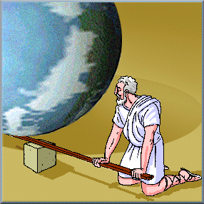
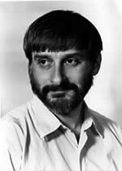
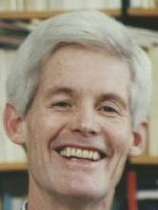
“Reduction”
“If you give me a place to
stand, I will move the earth.”
– Archimedes (~ 250BC)
“If you give me a polynomial-time algorithm
for Boolean Satisfiability, I will give you a
polynomial-time algorithm for every NP
problem.” --- Cook, Levin (1971)
“Every NP problem can be disguised as
Boolean Satisfiability.”

Slide 13
If P = NP, then brilliance will become routine
Proofs of Math Theorems can be found
in time polynomial in the proof length
Patterns in experimental data can be found in time polynomial in the length of the pattern.
All current cryptosystems compromised.
Many AI problems have efficient algorithms.
“Would do for creativity what controlled nuclear fusion
would do for our energy needs.”

Slide 14
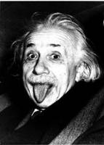
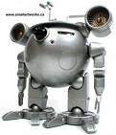
Vignette 2
What does it mean to learn?
(Theory of machine learning)
Can we turn into
Learning: To gain knowledge or understanding of or
skill in by study, instruction, or experience

Slide 15
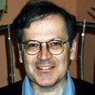
PAC Learning
(Probabilistic Approximately Correct)
Sample from a Distribution on
Datapoints: Labeled n-bit vectors
(white, tall, vegetarian, smoker,…,) “Has disease”
(nonwhite, short, vegetarian, nonsmoker,..) “No disease”
V
L. Valiant
Desired: Short OR-of-AND (i.e., DNF) formula that
describes ρ fraction of data (if one exists)
Distribution
V
V
V
V
(white vegetarian) (nonwhite nonsmoker)
Question: What concepts can be learnt in polynomial time?

Slide 16
Benefits of PAC definition
Impossibility results: learning many concepts is as hard as
solving well-known hard problems (TSP, integer factoring..)
→ implications for goals/methodology of AI
New learning algorithms: Fourier methods, noise-tolerant
learning, advances in sampling, VC dimension theory, etc.
Radically new concepts: Example: Boosting (Freund-Schapire)
Weak learning (ρ = 0.51) → Strong learning (ρ = 0.99)

Slide 17


Vignette 3
What does it mean to learn nothing?
Suggestions?
Encrypted message
Encrypted message is
statistically random
(cumbersome to achieve)
Encrypted message
“looks” like something
Adversary could efficiently
generate himself.
Achievable;
Aha! moment for
modern cryptography;

Slide 18
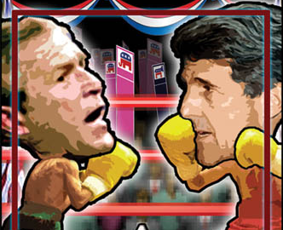
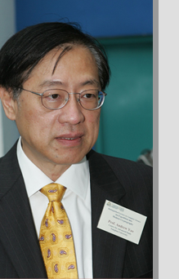
Example: Public closed-ballot elections
Hold an election in this room
  Everyone can speak publicly (i.e. no computers, email, etc.)
  At the end everyone must agree on who won and by what margin
  No one should know which way anyone else voted
Is this possible?
  Yes! (A. Yao, 1985)
“Privacy-preserving Computations” (Important research
area)

Slide 19
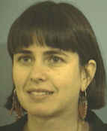


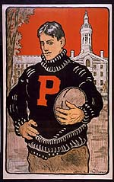
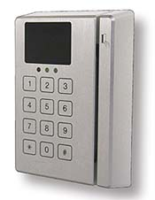
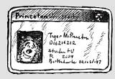
Zero Knowledge Proofs [Goldwasser, Micali, Rackoff ’85]
Desire: Prox card reader should not store “signatures” – potential security leak
Just ability to recognize signatures!
Learn nothing about signature except that it is a signature
Student
prox card
prox card reader
“ZK Proof”: Everything that the verifier sees in the interaction, it
could easily have generated itself.

Slide 20
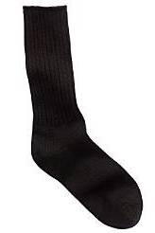
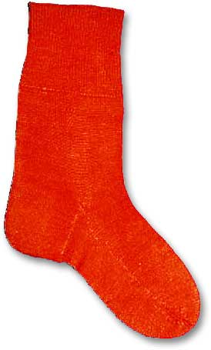
Illustration: Zero-Knowledge Proof that “Sock A is different from sock B”
Usual proof: “Look, sock A has a tiny hole and sock B doesn’t!”
ZKP: “OK, why don’t you put both socks behind your back. Show me a random one, and I will say whether it is sock A or sock B. Repeat as many times as you like, I will always be right.”
Why does verifier learn “nothing”? (Except that socks are indeed different.)
Sock A
Sock B

Slide 21
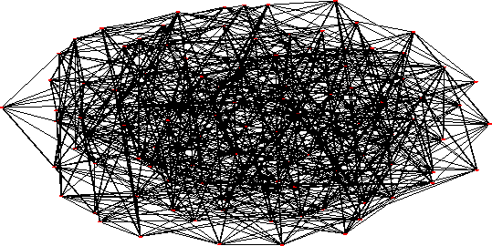
How to prove that something doesn’t exist
(ZK proof for graph nonisomorphism; template for many other protocols)
Task: Prove to somebody that two
graphs G₁, G₂ are not isomorphic
Verifier randomly (and privately) picks
one of G₁, G₂ and permutes its vertices to get H.
Prover has to identify which of G₁, G₂ this graph came from.
a graph
Verifier learns nothing new!

Slide 22
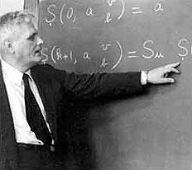
Vignette 4
What is the computational power of physical
systems?
Church-Turing Thesis:
Every physically realizable
computation can be performed
on a Java program. (Or Turing machine)
Intuition: “Just write a Java program to simulate the physics!”

Slide 23
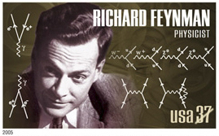
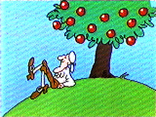
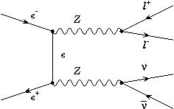
Strong form of Church Turing Thesis
Every physically realizable computation can be performed on a Turing Machine with polynomial slowdown (e.g., n steps on physical computer → n² steps on a TM)
Feynman(1981): Seems false
if you think about quantum mechanics
QED
(1670) F = ma etc.

Slide 24
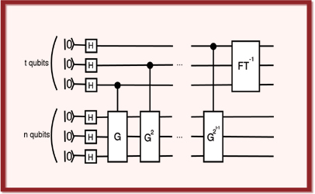
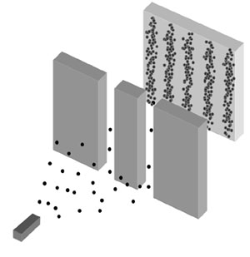
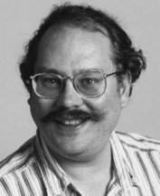
QM → Electron can be “in two
places at the same time”
→ n electrons can be “in 2^{n}
places at the same time”
(massively parallel computation??)
Quantum Fourier Transform
“Quantum computers” can factor
integers in polynomial time.
Peter Shor
Can quantum computers be built or does quantum mechanics need to be revised?
Physicists(initially): “No” and “No”.
Noise!!
Shor and others:
Quantum Error Correction!

Slide 25
Some recent speculation
(A. Yao) Computational complexity of physical theories (e.g.,
general relativity)?
(Denek and Douglas ‘06): Computational complexity as a
possible way to choose between various solutions
(“landscapes”) in string theory.

Slide 26
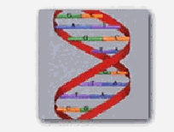
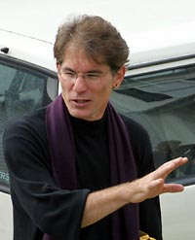
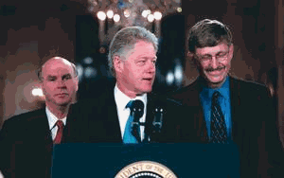
Vignette 5
Is algorithmic thinking the future of social and natural
sciences?
Gene Myers, inventor
of shortgun algorithm
for gene sequencing
Summer 2000

Slide 27
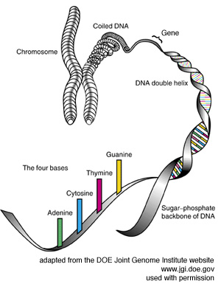
Shotgun sequencing
Goal: Infer genome (long sequence of A,C,T,G)
Method:
Extract many random fragments of selected sizes (2, 10, 50 150kb)
For each fragment, read first and last 500-1000 nucleotides (paired reads)
Computationally assemble genome from paired reads.
“Algorithm driven science”

Slide 28
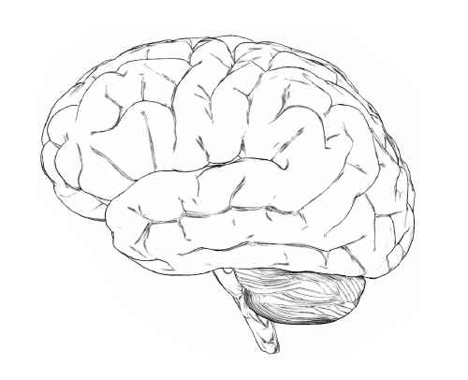
Other emerging areas of interest
Mechanism design
(e.g. for sponsored
ads on )
Understanding the “web” of connections on the WWW
(hyperlinks, myspace, blogspot,..)
> $10B/year
millions of mini “auctions”
per second
economics + algorithms!
Quantitative Sociology?
Nanotechnology;
Molecular self-assembly
Massively parallel,
error-prone computing?

Slide 29
Vignette 6
Do you need to read a math proof completely to
check it?
(PCP Theorem and the intractability of finding
approximate solutions to NP-hard optimization problems)
Recall: Math can be axiomatized (e.g., Peano Arithmetic)
Proof = Formal sequence of derivations from axioms
“PCP” : Probabilistically Checkable Proofs

Slide 30
Verification of math proofs
NP = PCP(log n, 1)
[A., Safra’92] [A., Lund, Motwani, Sudan, Szegedy ‘92]
(spot-checking)
n bits
Theorem
Proof
M
O(1) bits
M runs in poly(n) time
Theorem correct → there is a proof that M accepts w. prob. 1
Theorem incorrect → M rejects every claimed proof w. prob 1/2

Slide 31
An implication of PCP result
If you ever find an algorithm that computes a 1.02-approximation
to Traveling Salesman, then you can improve that algorithm
to one that always computes the optimum solution.
→ Approximation is NP-complete!
(Similar results now known for dozens of other problems)
Other applications: cryptographic protocols, error correcting
codes.
(Also motivated a resurgence in approximation algorithms)

Slide 32
I can’t wait to see what the next 30 years will bring!
Theoretical CS
Thank You

